Slide 1
Rotary Leadership Institute of Northeast America
www.rlinea.org
V-4- 9/4/2014

Slide 2
What is the Rotary Leadership Institute?
A Leadership and Development Program - Strengthens Rotary clubs - Provides Education, Collaboration and Ideas Exchange - Develops Future and Current Leaders
A Three Class Curriculum - Facilitated by Experienced Faculty Members - Engages Participants to Share Their Successes - Open Discussion, Problem-Solving, Creative Role-Play
Not an Official Program of Rotary International - Offered in >300 Rotary Districts to Members

Slide 3
Why attend the Rotary Leadership Institute?
Gain knowledge, proficiency and mastery in the areas of….
Leadership Development
Rotary Knowledge
Exchange of Ideas
Member Engagement
Service Project Leadership
Strategic Planning
Improving Communication
Team Building
Public Relations
International Perspectives

Slide 4
How does RLI work ?
Three Classes - 1, 2 & 3 - One Class per Day - Saturdays (usually) - 8:00am - 3:30pm (approx) - 6 or 7 topics/class - 50 minutes/class
Discussion and Involvement - Structured Conversations - No Lectures or PowerPoint
Participants Future Club Leaders New Members Active Rotarians
Skilled Facilitators - Experienced - Knowledgeable - The BEST of the BEST !

Slide 5
Topics - LEADERSHIP
Class I Characteristics of Leadership - Motivational Techniques
- Leadership Styles
Class II Team Building
- Committees as Leadership Tools
Class III Effective Leadership Strategies
- Lead and Communicate in Groups - How to Win Support For Goals

Slide 6
Topics -
Class I Purpose and Structure of Rotary
Class II Rotary Opportunities
- Personal Growth
- Global Network Groups
- RI Structured Programs
Class III Making a Difference
- Improve Your Rotary Experience
- Use RLI Ideas
- Analyze RLI Program

Slide 7
Topics - Membership
Class I Engaging Members
- Active Participation
- Engagement Opportunities
Class II Attracting Members
- Targeting Key Audiences
Class III Vocational Service/Expectations
- Add Value to Rotary Membership

Slide 8
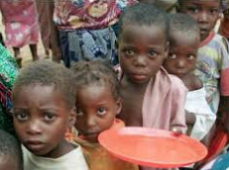
Topics – Rotary Foundation
Class I TRF Goals and Programs
- What is a Foundation?
- TRF value to clubs
Class II Targeted Service
- New Grant Model
- Six Areas of Focus
Class III International Service
- Build Connections
- Rotary Action Groups - “Service Above Self ”

Slide 9
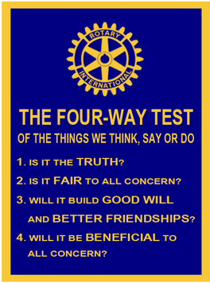
Topics – Ethics
Class I Practice Ethical Behavior
- Promoting Ethics With Others
- Strengthen Your Own Vocation
- Promoting the 4-Way Test

Slide 10
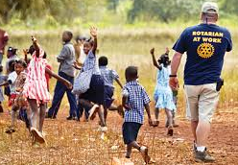
Topics – Service Projects
Class I Project Implementation - Planning, Leading and DOING ! - Creativity/Sustainability
- Rotary Resources & Capacity

Slide 11
Topics – Communications
Class II Effective Communications - Internal to Clubs - external to Communities
Class III Public Image and PR
- Public Relations Strategy - Reaching Target Audiences

Slide 12
Topics – Strategic Planning
and Analysis
Class II Insightful Club Planning - Club Review and Analysis
- Areas of Improvement

Slide 13
Graduate Courses
Ethics in Rotary
Ethics versus Morality
Meaning of our Rotary Motto and 4-Way Test
Steps to Ethical Decisions
Case Studies to Enhance Your Learning
The Council on Legislation
What is the Council ?
How the Council affects Clubs
Preparing and Submitting Proposals for Action
Debate Pro and Con on Sample Issues

Slide 14
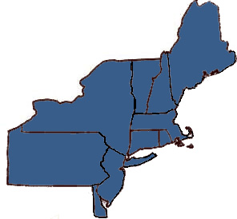
Locations
Canandaigua, NY
Loudonville, NY
Melville, NY
New Rochelle, NY
Newburgh, NY
Owego, NY
Verona, NY
Harrisburg, PA
King of Prussia, PA
Wilkes-Barre, PA
Montvale, NJ
Cherry Hill, NJ
West Orange, NJ
Wilmington, DE
Lewiston, ME
Wells, ME
Saxton, VT
Lebanon, NH
West Haven CT
Lincoln, RI
Boxborough, MA
Chicopee, MA
Peabody, MA

Slide 15
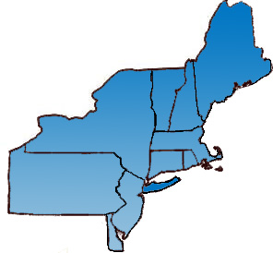
Locations
Canandaigua, NY
Loudonville, NY
Melville, NY
New Rochelle, NY
Newburgh, NY
Owego, NY
Verona, NY
Harrisburg, PA
King of Prussia, PA
Wilkes-Barre, PA
Montvale, NJ
Cherry Hill, NJ
West Orange, NJ
Wilmington, DE
Lewiston, ME
Wells, ME
Saxton, VT
Lebanon, NH
West Haven CT
Lincoln, RI
Boxborough, MA
Chicopee, MA
Peabody, MA

Slide 16
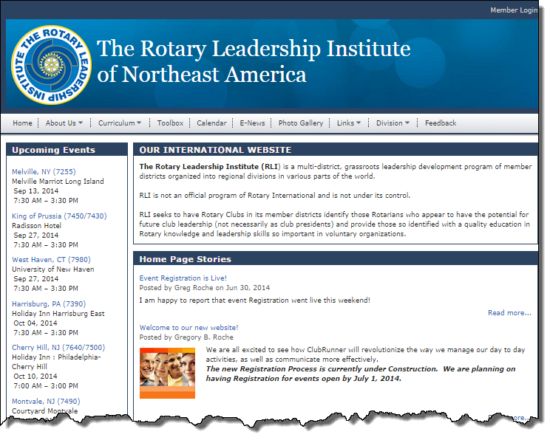
Course Registration
www.rlinea.org
REGISTER Click on Your Desired Course Location
Rotary Leadership Institute Northeast East America

Slide 17
Rotary Leadership Institute of Northeast America
Questions…
Thoughts…
Comments…
www.rlinea.org

